Slide 1
Module II Supervised and Unsupervised Learning
Least Squares , Under-fitting / Overfitting, Cross Validation

Slide 2
Least Squares
Least Squares Method is a standard statistical technique used to find the best-fit line or curve by minimizing the sum of squared deviations between observed and predicted values.
The best fit is obtained by minimizing the sum of the squares of the residuals, where a residual is the difference between the observed value and the value predicted by the model.
The least squares method is extensively applied in data fitting, regression analysis, and machine learning models, especially when the number of equations exceeds the number of unknowns.
It provides an optimal solution by minimizing errors and is commonly used in both linear and non-linear regression problems.

Slide 3
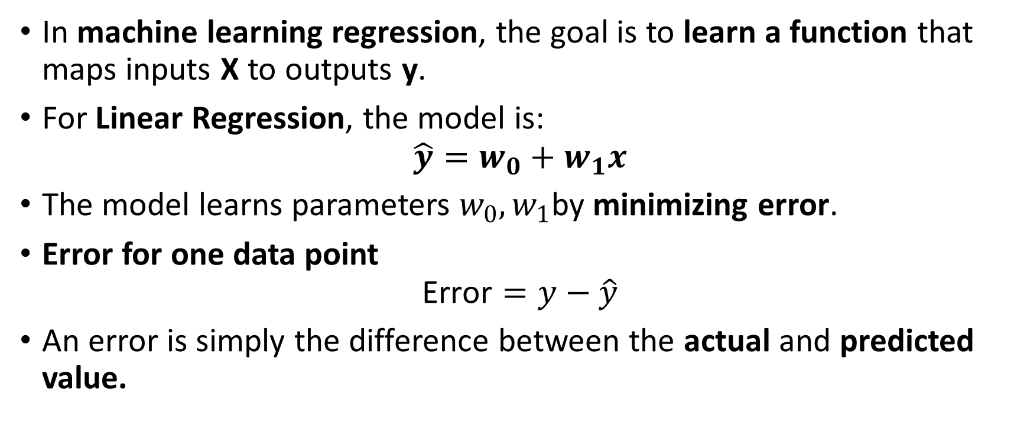
Least Squares Means in ML
In machine learning regression, the goal is to learn a function that maps inputs X to outputs y.
For Linear Regression, the model is:
$$\hat{y}=w_{0}+w_{1}x$$
The model learns parameters $w_{0},w_{1}$by minimizing error.
Error for one data point
$$\text{Error}=y−\hat{y}$$
An error is simply the difference between the actual and predicted value.

Slide 4
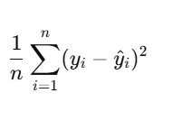
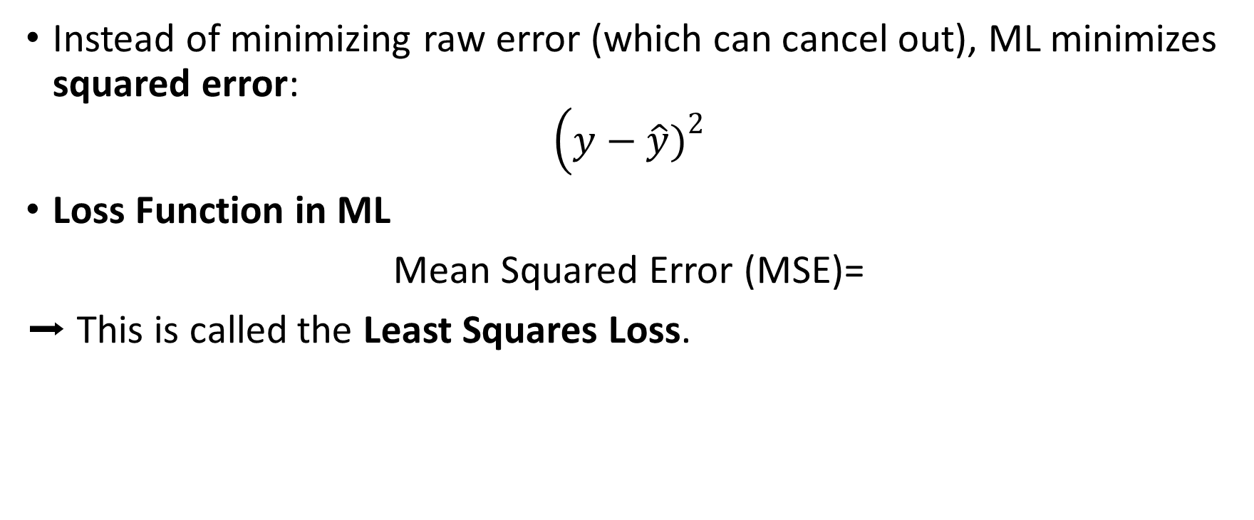
Least Squares Principle
Instead of minimizing raw error (which can cancel out), ML minimizes squared error:
$$\left(y−\hat{y}{\left.)\right.}^{2}\right.$$
Loss Function in ML
Mean Squared Error (MSE)=
➡ This is called the Least Squares Loss.

Slide 5
Why Squaring the Error?
Avoids positive & negative cancellation
Penalizes large errors heavily
Differentiable → easy optimization using Gradient Descent

Slide 6
ML Training Workflow (Least Squares)
Initialize model parameters
Predict output
Calculate Least Squares loss (MSE)
Update parameters to reduce loss
Repeat until loss is minimized

Slide 7
Under-fitting / Overfitting
Overfitting and underfitting are common challenges in machine learning.
To evaluate a model’s performance, dataset categorized into:
Training Set: Used to train the model.
Testing Set: Used to evaluate how well the model generalizes.

Slide 8
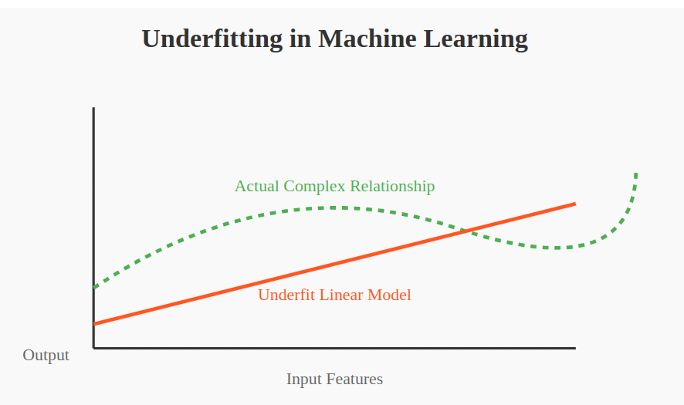
Underfitting
Underfitting happens when:
Model is too simple
Cannot learn patterns in data
Performs poorly on both training & testing data

Slide 9
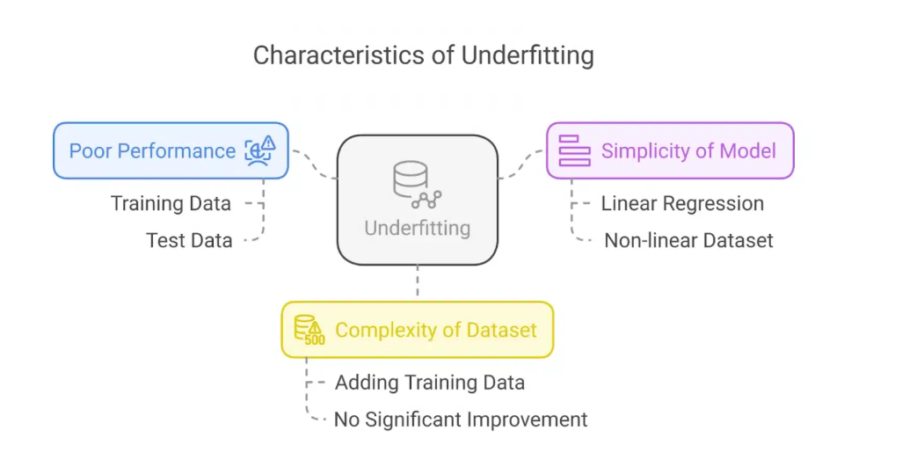
Characteristics of Underfitting

Slide 10
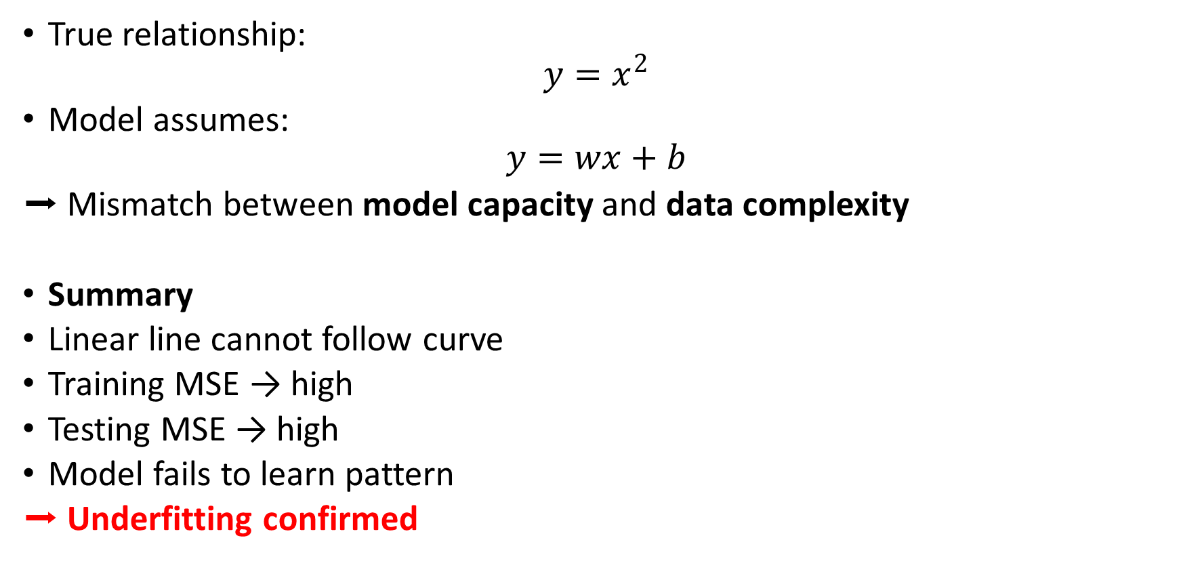
Mathematical View
True relationship:
$$y=x^{2}$$
Model assumes:
$$y=wx+b$$
➡ Mismatch between model capacity and data complexity
Summary
Linear line cannot follow curve
Training MSE → high
Testing MSE → high
Model fails to learn pattern
➡ Underfitting confirmed

Slide 11
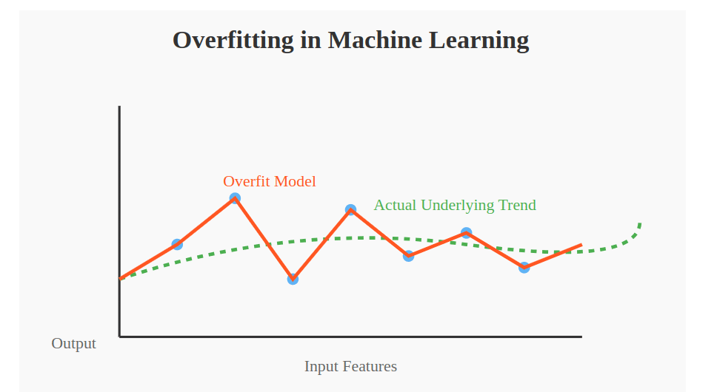
Overfitting
Overfitting occurs when:
Model is too complex
Learns noise instead of pattern
Very low training error
Very high testing error

Slide 12
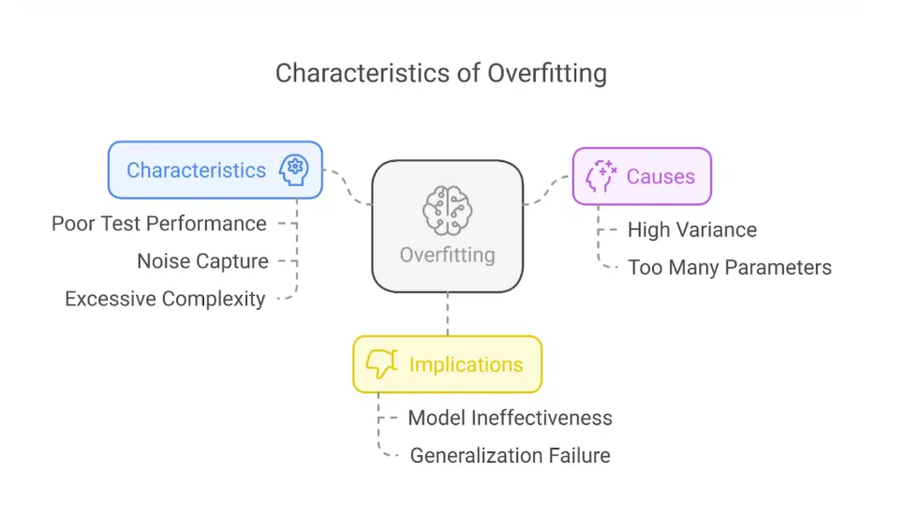
Characteristics of Overfitting

Slide 13
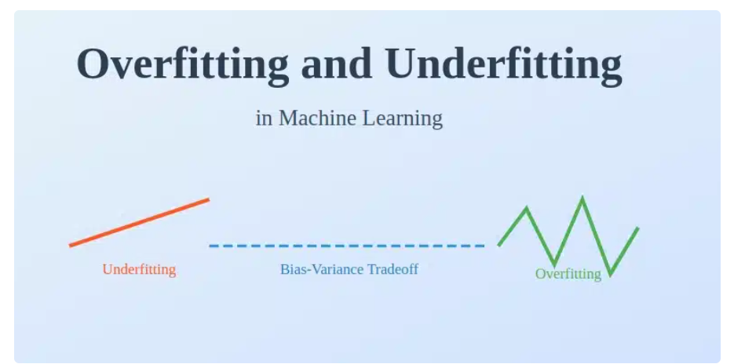
The Bias-Variance Tradeoff
The bias-variance tradeoff It represents the relationship between a model’s complexity and its ability to generalize well.
High Bias (Underfitting): The model makes strong assumptions about the data and fails to capture patterns.
High Variance (Overfitting): The model is too sensitive to small fluctuations in the data, leading to poor generalization.

Slide 14
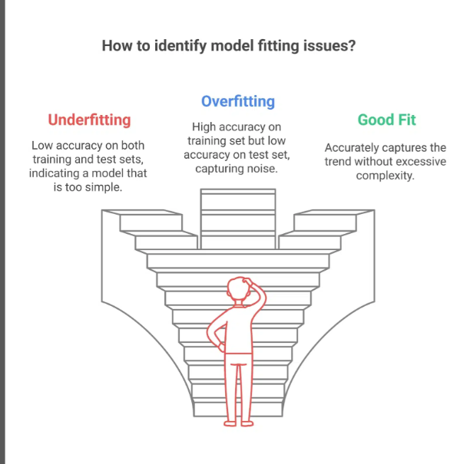
Graphical Representation

Slide 15
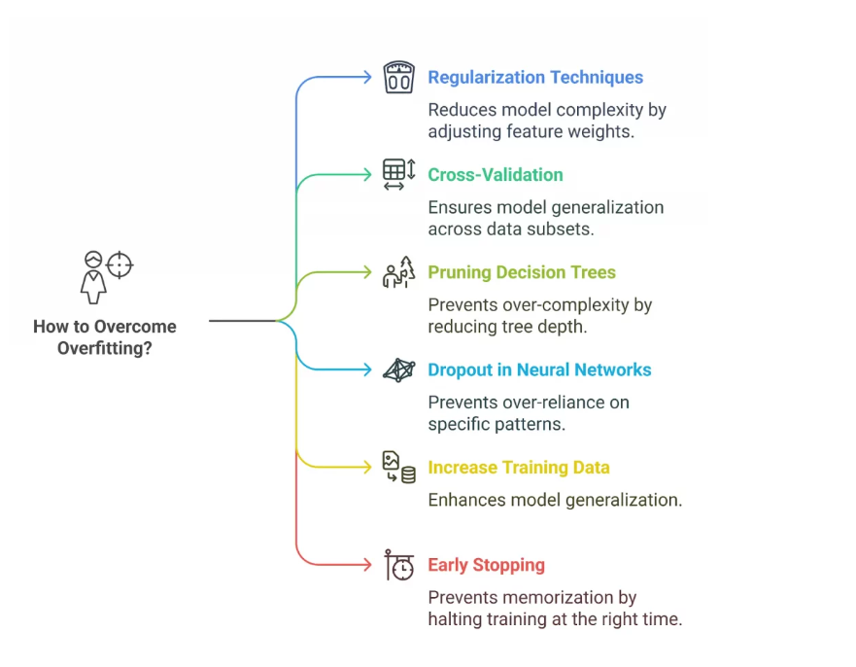
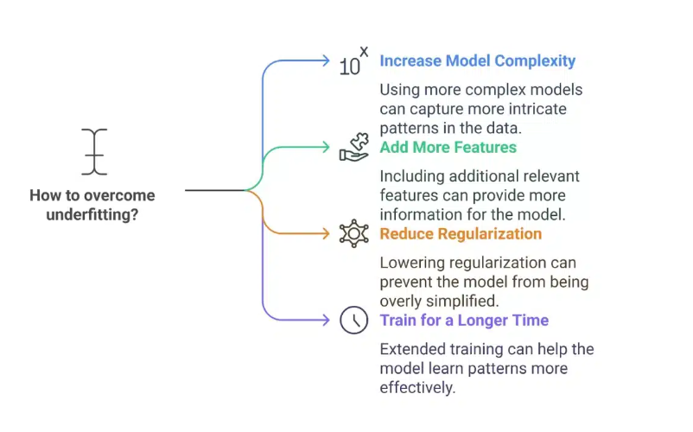
Techniques to Overcome Underfitting and Overfitting

Slide 16
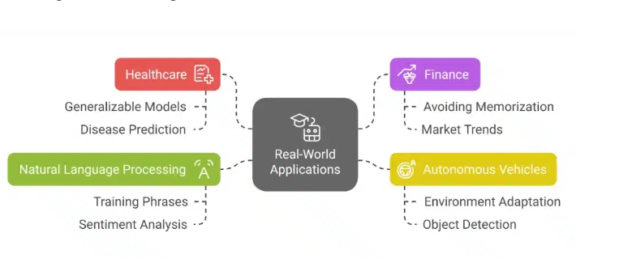
Real-World Applications

Slide 17
Cross-Validation
Cross-Validation is a technique used to evaluate and improve model generalization by testing it on multiple data splits.
Need of cross validation
Detects overfitting
Ensures model reliability
Uses data efficiently
Cross-validation ensures:
Better use of available data
Stable and unbiased performance estimation
Reliable model selection

Slide 18
Cross-Validation Works
Dataset is divided into multiple parts (folds)
Model is trained on some folds
Model is tested on the remaining fold
This process is repeated multiple times
Final performance = average of all test results

Slide 19
Types of Cross-Validation
Hold-Out Validation (Basic)
Data split once into training and testing sets
K-Fold Cross-Validation
In K-Fold Cross-Validation, the dataset is divided into K equal-sized folds.
Stratified K-Fold (Classification)
Useful for imbalanced datasets
Leave-One-Out Cross-Validation (LOOCV)
Train on all except one sample

Slide 20
Advantages of Cross-Validation
Efficient use of limited data
Reliable performance estimation
Helps detect overfitting
Improves model selection

Slide 21
Limitations of Cross-Validation
Computationally expensive
Not ideal for very large datasets
Complex models increase training time

